Slide 1
Host Training Meeting Fall 2016 Life Group Launch

Slide 2
Introduction Welcome Prayer

Slide 3
At Table Quickly Share…
Your Name
What brought you to St. John’s?

Slide 4
What’s the Great Commission?

Slide 5
¹⁸ Then Jesus came to them and said, “All authority in heaven and on earth has been given to me. Matthew 28:18-20

Slide 6
¹⁹ Therefore go and make disciples of all nations, baptizing them in the name of the Father and of the Son and of the Holy Spirit, Matthew 28:18-20

Slide 7
²⁰ and teaching them to obey everything I have commanded you. And surely I am with you always, to the very end of the age.” Matthew 28:18-20
Notes:
Teaching – not a classroom – Rabbi’s disciples lived whole lives
Obey – keep, observe.

Slide 8
Thank You
You are living out the
Great Commission
Making Disciples

Slide 9
The Early Disciples
The Early Church CONNECTED to God and His People in a large group in the Temple Courts
They GREW together in the Word in houses.

Slide 10
Hebrews 10
Let us consider how we may spur one another on toward love and good deeds.
Let us not give up meeting together…
Let us encourage one another...

Slide 11
Discipleship Process!

Slide 12
Discipleship Process
CONNECT to God and His People in Worship

Slide 13
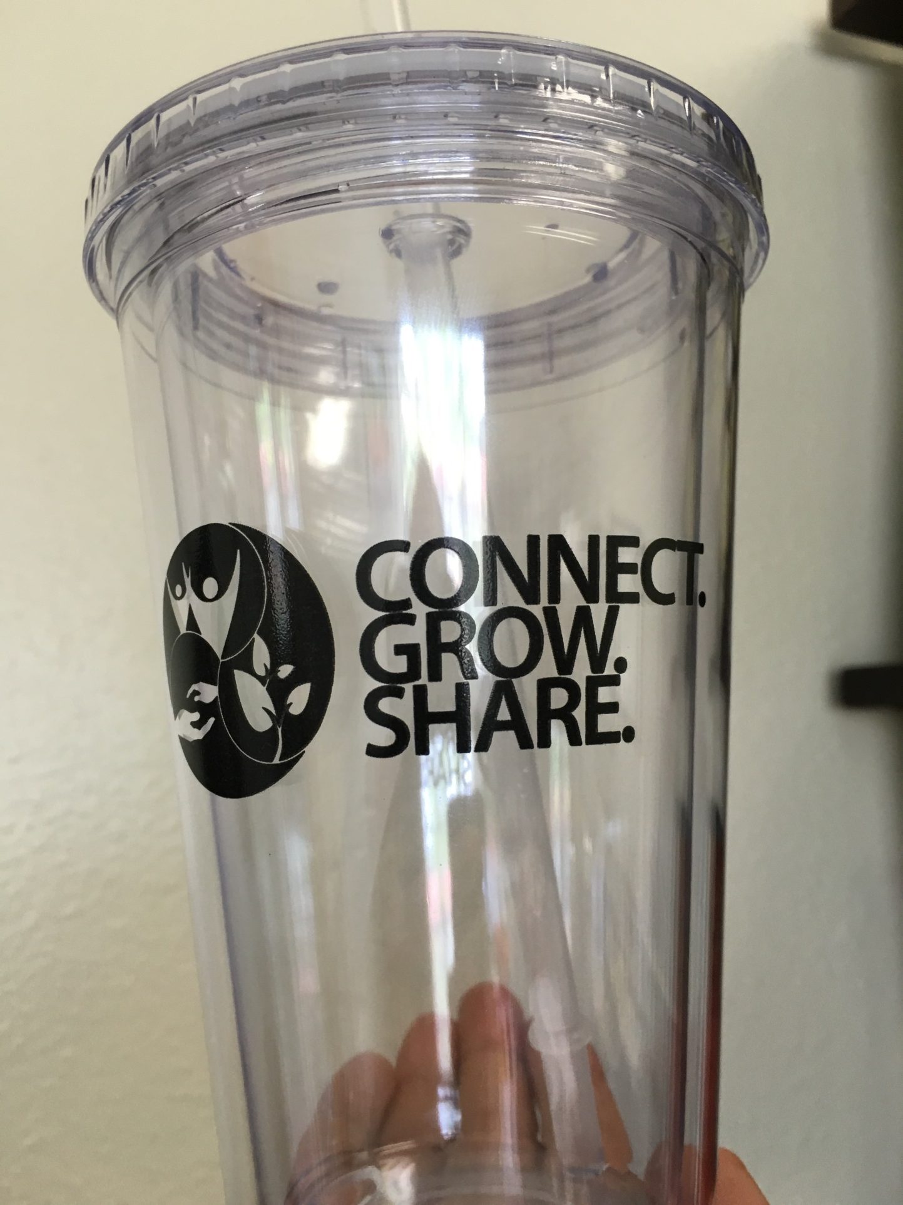
Notes:
In worship we fill ourselves up – and then it overflows… in worship and in life…

Slide 14
Discipleship Process
GROW together in God’s Word through Life Groups

Slide 15
DISCOVER COMMUNITY
An Illustration of Community
UFO Balls
Notes:
Ufo balls…
Carabiners

Slide 16
Notes:
Ufo balls…
Carabiners – connect you to the rock and to each other -

Slide 17
Discipleship Process
SHARE Christ with our
words, service, and resources

Slide 18
Discover SHARE…
Jesus said, “I am the light of the world.…” John 8:12
Jesus said, “You are the light of the world….” Matthew 5:14

Slide 19
Thank you for being disciples that make disciples.

Slide 20
Life Groups
Why are they important?
Bill Hoyt: Every Growing Large Church has a vibrant Life Group Ministry

Slide 21
Life Groups
Why are they important?
Spiritual Health
Life Groups serve as a way to assess spiritual health and grow with other believers.

Slide 22
Life Groups
Why are they important?
Family - Community
With the decline of the family in America and lack of meaningful relationships people are in need of healthy Biblical community.

Slide 23
Life Groups
Testimony to the power of a Life Group.
Importance of Your Service

Slide 24
Life Groups
The Number One way to launch new small groups.

Slide 25
Life Group “Guides”
More connections between HOSTs.
Support Each Other
Learn From Each Other
Prayer Support

Slide 26
In your folder…
Host Information Booklet
Page 4 -What Makes a Healthy Life Group?
Page 6 – Steps and Curriculum
Notes:
Pages 1-4

Slide 27
Break-out Session
New HOSTs
Veteran HOSTs

Slide 28
With those around you quickly share…
A Favorite Hobby - Interest

Slide 29
In your folder…
Host Information Booklet
Page 7
Take a few minutes to jot answers and then discuss one answer at your table

Slide 30
In your folder…
Host Information Booklet
Page 8-10
What does God want for us/me?
What’s Next?

Slide 31
Web Resources
www.stjohnsorange.org/lifegroups →HOST Resources
www.rightnowmedia.org

Slide 32
Group Information and Attendance
See your group, Email them, contact information, take attendance
Notes:
Review this only, most should know how to use it, go over why taking attendance is so important.

Slide 33
As you leave…
Get study guides
DVD
SHARE information

Slide 34
HOST Feedback Form Questions?

Slide 35
Thank You! Let’s Pray!

